Slide 1
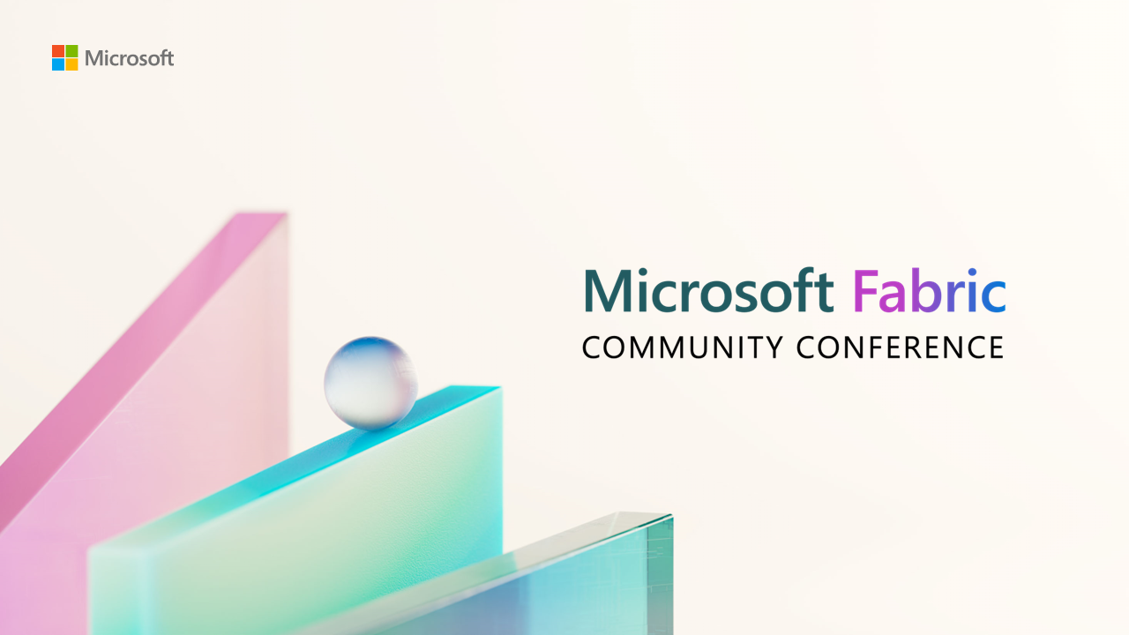

Slide 2
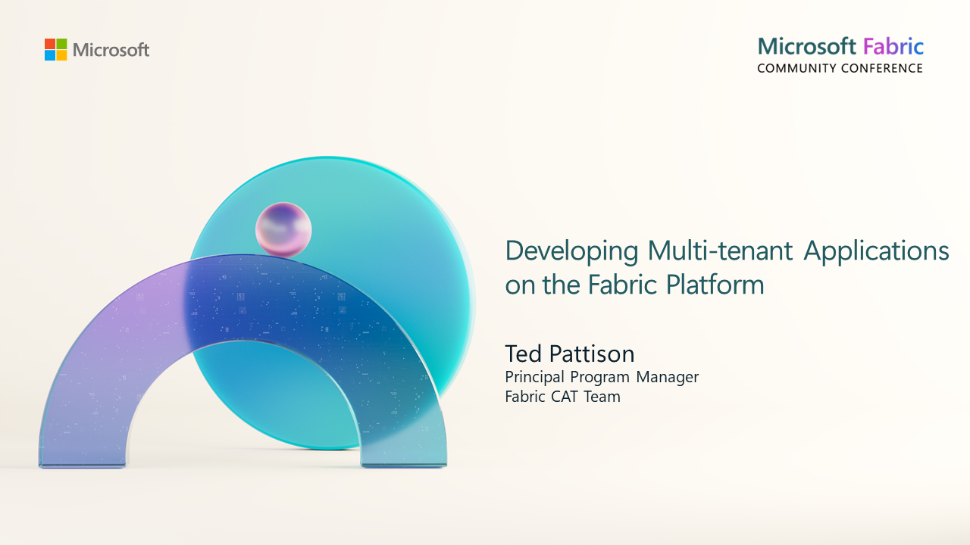
Quick Links to Workshop Material
GitHub: https://aka.ms/FabConWorkshop
Slides: https://aka.ms/FabConWorkshopSlides
Download: https://aka.ms/FabConWorkshopDownload

Slide 3
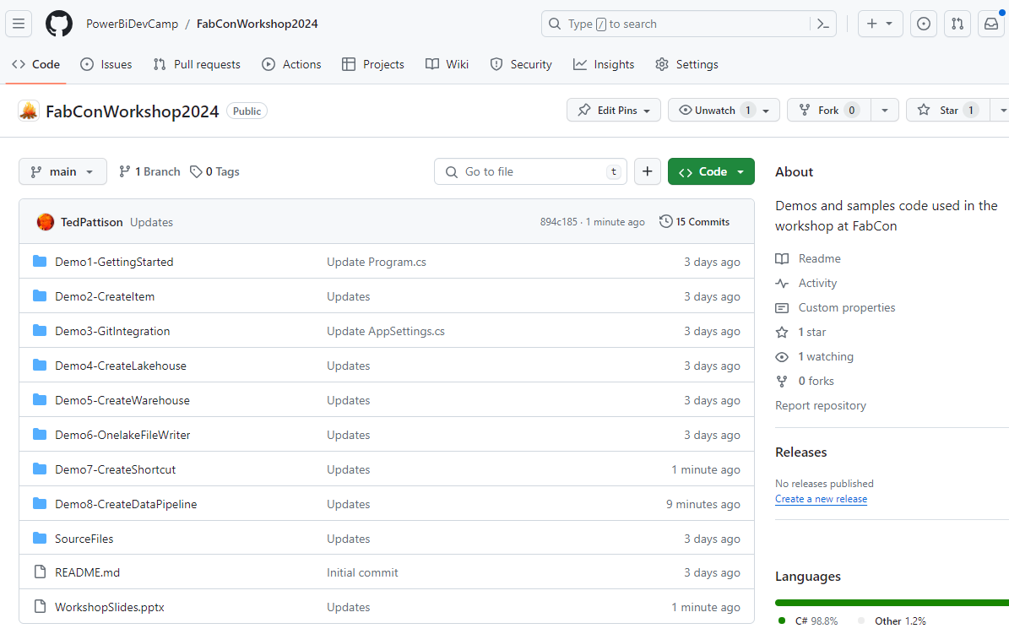
Downloads and Materials for This Workshop
All workshop materials available online on a GitHub repository
Download from https://github.com/PowerBiDevCamp/FabConWorkshop2024
Material contains eight developer sample projects created as C# console applications with .NET 8
Material contains workshop slides
Quick Links to Workshop Material
GitHub: https://aka.ms/FabConWorkshop
Slides: https://aka.ms/FabConWorkshopSlides
Download: https://aka.ms/FabConWorkshopDownload
slides

Slide 4
Agenda
Getting Started with the Fabric User APIs
Programming CreateItem using Item Definitions
Automating ALM and CI/CD with GIT Integration
Programming with Lakehouses and Notebooks
Provisioning and Building Data Warehouses
Accessing OneLake using the ADLS Gen2 APIs
Creating OneLake Shortcuts and Data Pipelines
Developing with Power BI Embedding on Fabric

Slide 5
Student Survey
What Languages?
JavaScript or TypeScript
C# or VB.NET
Python
Java
What else?
What development platforms?
Angular
React
.NET
Java
Node.js
Salesforce
What else?

Slide 6
Getting Started with the Fabric User APIs
Agenda for the Getting Started session
Motivation for Multi-tenant applications
Understanding Fabric User API Architecture
Authentication and Access Token Acquisition
Viewing Fabric Workspaces and Capacities
Creating Fabric Workspaces
Configuring Access by Assigning Workspace Roles

Slide 7





Developing Multi-tenant Applications in Fabric
Multi-tenant application is responsible for creating and managing customer tenants
Customer tenant created using one or more Fabric workspaces
Developer uses Fabric User APIs to create and configure workspace items
Workspace items include lakehouses, notebooks, semantic models and reports
Fabric Multi-tenant Environment
Azure AD Tenant Owned by ISV
Customer 01 Tenant Workspace
Customer 01
17 users
lakehouse
notebook
model
report
Custom ISV Application
Customer 02 Tenant Workspace
lakehouse
notebook
model
report
Customer 02
85 users
Customer N Tenant
lakehouse
notebook
model
report
Customer N
450 users

Slide 8
Developer APIs used in Fabric Software Development
Fabric User API
New REST API introduced with the Fabric platform to create workspaces and workspace items
Power BI REST API
REST API used to patch credentials, refresh semantic models and to generate embed tokens
Spark APIs
Powerful APIs and libraries for data ingestion and data transformation accessible in Fabric Notebooks
ADLS Gen2 API
REST API used to upload and read files in Azure Data Lake storage (ADLS Gen2) and in OneLake storage
Tabular Object Model (TOM)
A .NET-based API used to read and update semantic model definitions through the XMLA endpoint

Slide 9
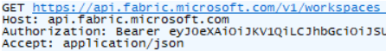
Fabric User API Design and Architecture
Fabric User API used to create and manage workspaces and workspace items
Fabric User API designed to be accessible to any developer on any development platform
Built using principles of REST and open security standards (OAuth2 and Open ID Connect)
Public cloud endpoint accessible through base URL of https://api.fabric.microsoft.com/v1
Fabric User API can be called as a [user] or as a [service principal]*
Caller must first acquire access token for Fabric User API from Azure AD
Caller must transmit access token in all API calls using Authorization header
CAVEAT – There is no .NET SDK for the Fabric REST APIs yet – that will come sometime in the future
service principal support expected by May 2024
Your Application
Fabric User APIs
access token
JSON Result
HTTP Response: 200 OK

Slide 10
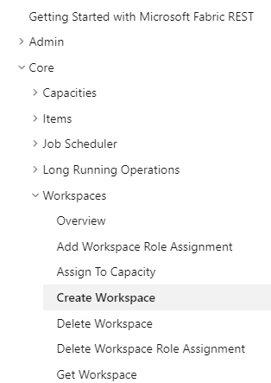
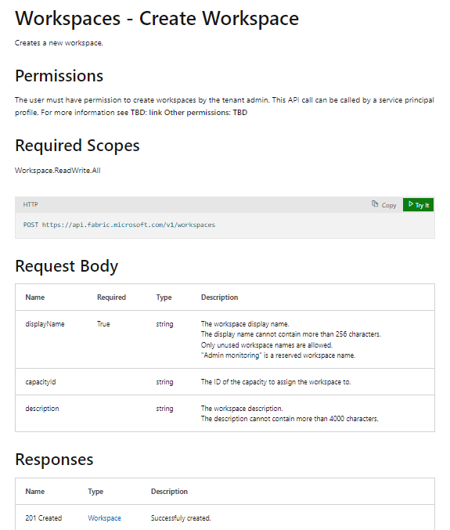
RTFM! = Read The Fabric Documentation
Fabric REST APIs documentation available online is essential developer resource
https://learn.microsoft.com/rest/api/fabric

Slide 11
Fabric User API Item Types
Fabric introduces programming model based on item types
Platform item types are scoped at tenant level
Workspace item types are scoped at workspace level
Workspace item types are categorized by Fabric Workload
Workspace item type Dataset has been renamed to SemanticModel
Platform Item Types
Supported
Capacity
Workspace
Connection
Coming Soon
Workspace Item Types by Workload
Unsupported
Power BI
Data Engineering
Data Warehouse
Data Factory
Real-time Analytics
Data Science
SemanticModel
Lakehouse
Warehouse
DataPipeline
EventHouse
MLExperiment
Report
Notebook
MirroredWarehouse
Dataflow
KQLDatabase
MLModel
PaginatedReport
SparkJobDefinition
KQLDataConnection
Shortcut
KQLQueryset
Environment
Eventstream

Slide 12
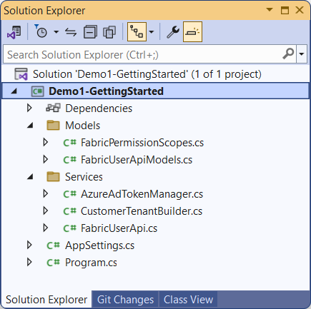
Demo1–GettingStarted
One of eight developer samples included with workshop content
Downloaded from GitHub repository at https://github.com/PowerBiDevCamp/FabConWorkshop2024
Created as simple console application using C# and .NET 8
Can be opened and run using any version of Visual Studio 2022

Slide 13
Important C# Classes in Models Folder
FabricPermissionScopes - delegated permission scopes for Fabric User API
FabricUserApiModels.cs - serialization classes to convert between JSON and .NET objects

Slide 14
Important C# Classes in Services Folder
AzureAdTokenManager - used to acquire access tokens from Azure AD
CustomerTenantBuilder - contains high-level logic for provisioning customer tenants
FabricUserApi - used to execute HTTP requests to Fabric User API

Slide 15
Acquiring Access Tokens using MSAL
Leverage Microsoft Authorization Libraries (MSAL)
Used for authentication and access token acquisition
MSAL libraries provide developer productivity while supporting Microsoft security best practices
MSAL libraries provide support for caching access tokens and refresh tokens behind the scenes
More info at https://learn.microsoft.com/en-us/entra/identity-platform/msal-overview
MSAL libraries on other platforms
MSAL.NET
MSAL for Android
MSAL Angular
MSAL for iOS and macOS
MSAL Java
MSAL.js
MSAL Node
MSAL Python
MSAL React
MSAL libraries provide support for…
Web applications
Web APIs
Single-page apps (JavaScript)
Mobile and native applications
Daemons and server-side applications

Slide 16
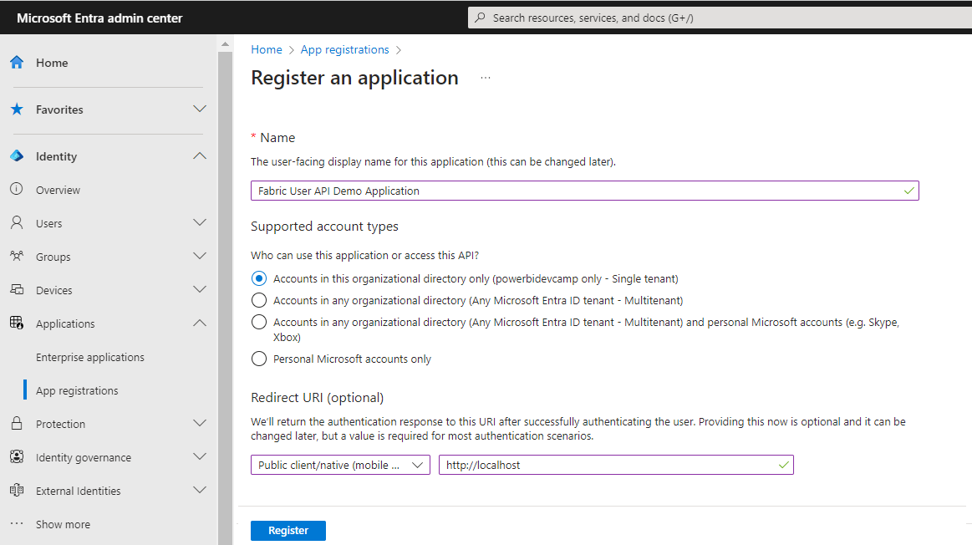
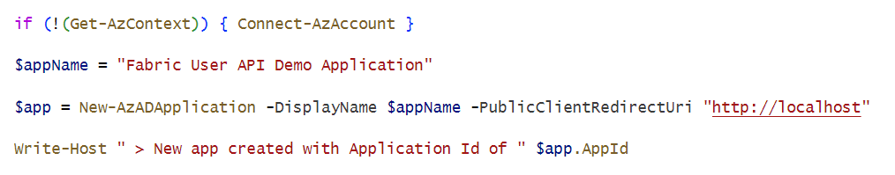
Creating New Entra Id Application
You need Entra ID application (aka Azure AD application)
Microsoft recently renamed Azure Active Directory to Microsoft Entra ID
Creating new application in the Entra ID portal at https://entra.microsoft.com/
Creating new Entra ID application using PowerShell

Slide 17
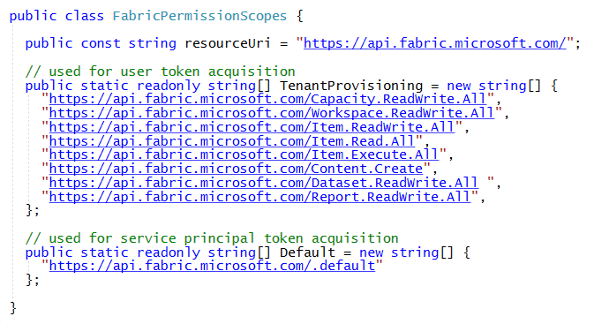
Authentication and Access Token Acquisition
Authenticating as user requires adding delegated permission scopes to access token
Required permission scopes should be passed in request to acquire access token from Azure AD
Delegated permission scopes for Fabric APIs have resource URI of https://api.fabric.microsoft.com/
Delegated permission scopes managed in FabricPermissionScopes class
Service Principal do not require delegated permission scopes
CAVEAT: There is not full support for service principal access in initial public preview release

Slide 18
Generic Item Scopes versus Specific Item Scopes
Generic permission scopes used to grant permissions to Fabric items of all types
Item.Read.All
Item.ReadWrite.All
Item.Execute.All
Item.Reshare.All
Specific permission scopes used to grant permissions to specific types of Fabric items
Lakehouse.ReadWrite.All
Notebook.ReadWrite.All
Notebook.Execute.All
SemanticModel.ReadWrite.All
SemanticModel.Reshare.All
Report.ReadWrite.All

Slide 19
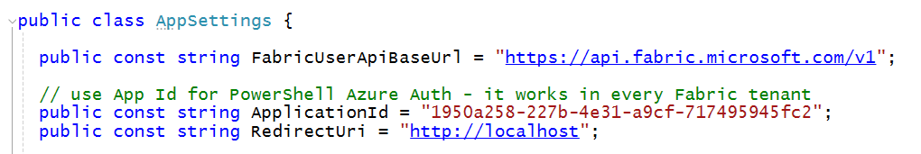
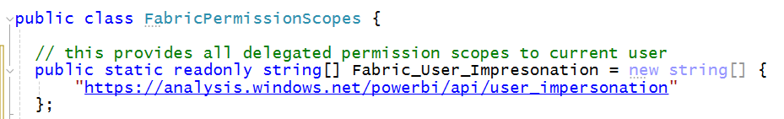
Authenticating with Microsoft Azure PowerShell Application
Microsoft Azure PowerShell application provides easier path for developer testing
Microsoft Azure PowerShell is Azure AD application available in all Azure AD tenants
Eliminates the need for creating an Azure AD application for developer testing
Produces all-powerful access tokens with all delegated permissions for Power BI and Fabric
Use the well-known application ID of 1950a258-227b-4e31-a9cf-717495945fc2
Acquire access token with user_impersonation delegated permissions
This is handy for developer testing – but it might not be appropriate for deploying production applications

Slide 20
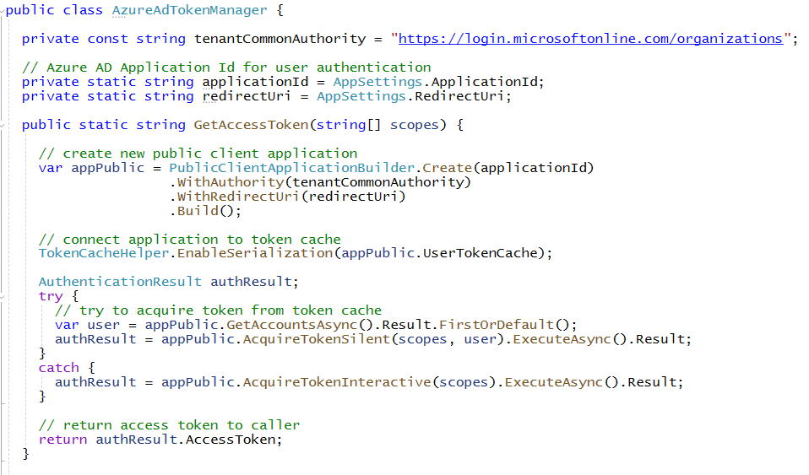
Acquiring Access Token for User using MSAL.NET
AzureAdTokenManager class used to to authenticate user and acquire access tokens
Uses MSAL.NET (Microsoft.Identity.Client) to implement Azure AD authentication flow
Desktop and console applications can use redirect URI of http://localhost
All demo projects leverage MSAL.NET support for caching access tokens and refresh tokens
Requires creating Azure AD application as public client with redirect URI of http://localhost
GetAccessToken first attempts to get token from cache before prompting user for login

Slide 21
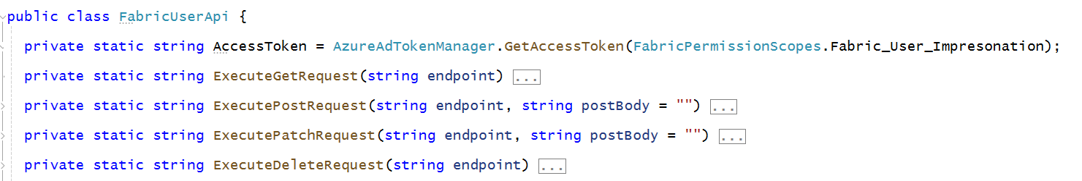
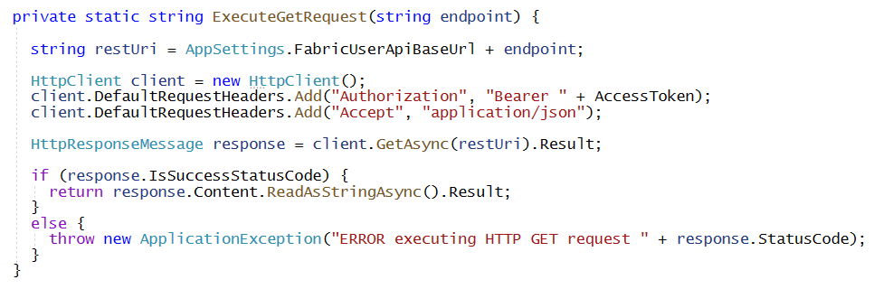
Transmitting Access Token in Fabric User API Calls
FabricUserApi class acquires access token at startup
No need to login interactively if application can retrieve access token or refresh token from cache
Methods which execute HTTP requests using HttpClient must add access token
Here's an example of ExecuteGetRequest adding Authorization header with access token

Slide 22
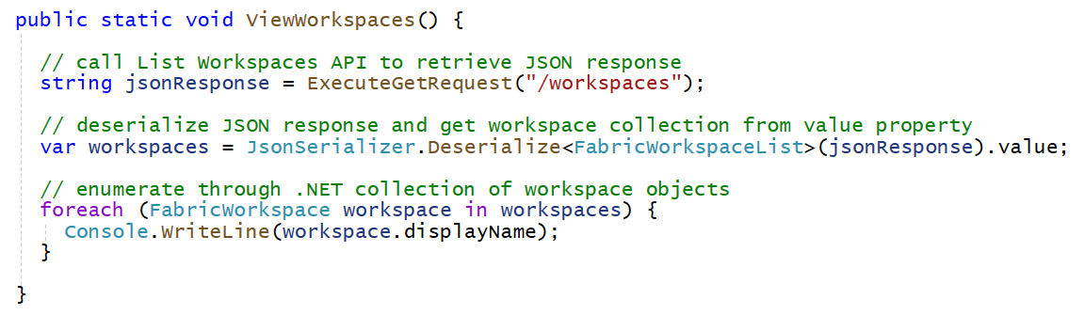
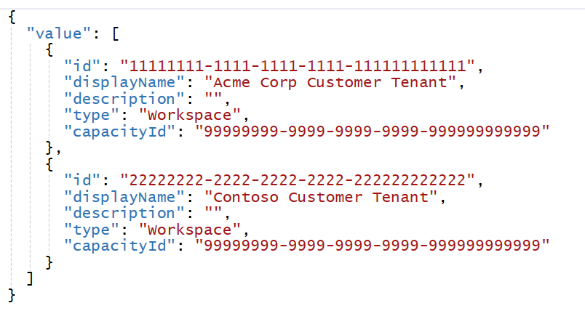
Executing Fabric API Calls with ExecuteGetRequest
Call ExecuteGetRequest by passing relative URL to endpoint
This examples calls List Workspaces API by passing /workspaces in call to ExecuteGetRequest
Calls to ExecuteGetRequest will automatically transmit access token in Authorization header
Fabric API returns response to GET request with JSON in response body
Your Application
Fabric User APIs
access token
JSON in Response Body
200 OK

Slide 23
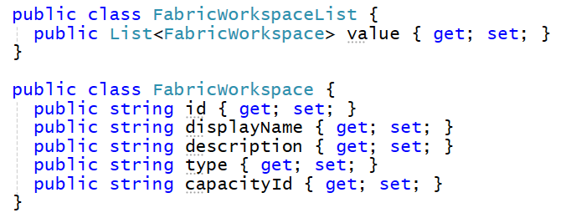
Deserializing JSON from the HTTP Response
C# serialization classes are used to convert between JSON and .NET object
Serialization classes used to deserialize response from List Workspaces API
Use JsonSerializer and Fabric serialization classes to deserialize JSON from response body
Creating C# classes that map to structured JSON

Slide 24
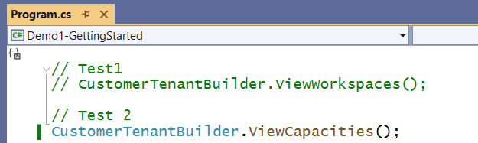
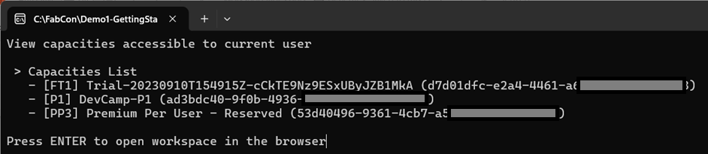
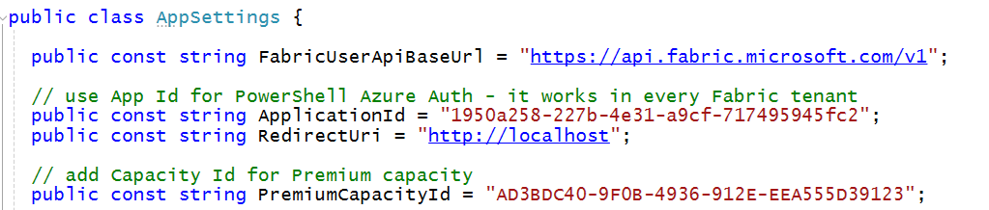
You Need a Premium Capacity Id for Testing
Run Test 2 to call CustomerTenantBuilder.ViewCapacities
View list of Premium capacities and copy the Id of one of them
Paste the Id of Premium capacity into PremiumCapacityId constant in AppSettings.cs
Copy and paste Premium capacity Id

Slide 25
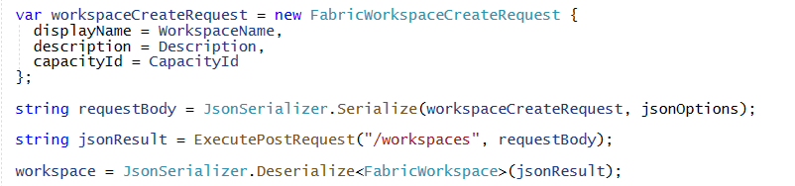
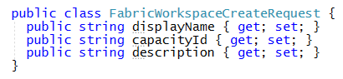
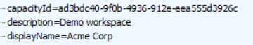
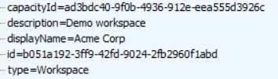
Create Workspace
Workspace created using POST operation with JSON body payload
Use JsonSerializer and Fabric serialization class to prepare JSON for request body
Successful call returns 201 CREATED and JSON response body contains Id of new workspace
Your Application
HTTP Request
Fabric User APIs
POST https://api.fabric.microsoft.com/v1/workspaces
HTTP Response
201 CREATED

Slide 26
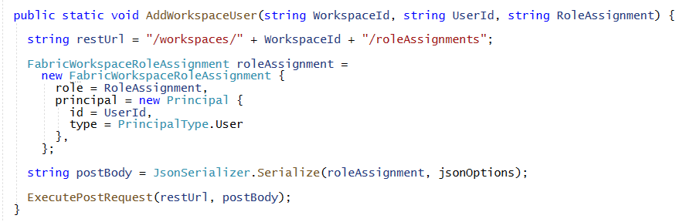
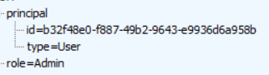
Add Workspace Role Assignment for User
Workspace role assignment added using POST operation with JSON body payload
User must be added using object Id of Azure AD user account (adding user by email not allowed)
Successful assignment of workspace role returns 200 OK
Your Application
HTTP Request
Fabric User APIs
POST https://api.fabric.microsoft.com/v1/workspaces/{WORKSPACE_ID}/roleAssignments
HTTP Response
200 OK

Slide 27
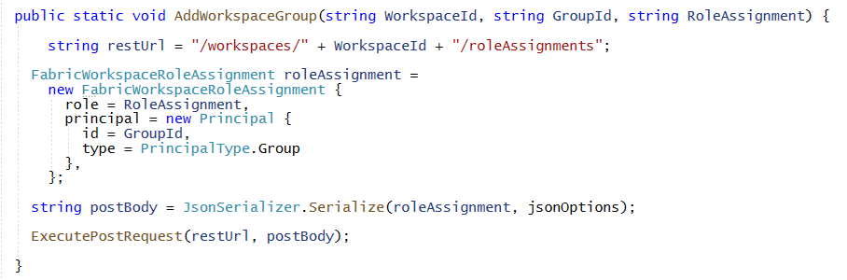
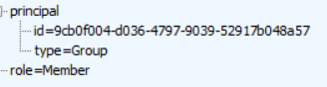
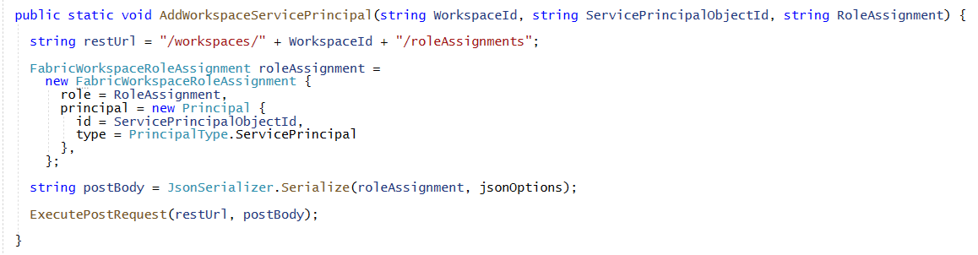
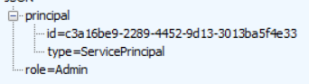
Assigning Roles to Azure AD Groups and Service Principals
Assigning workspace role to Azure AD group using object Id
Assigning workspace role to service principal using object Id
JSON in request body
JSON in request body

Slide 28
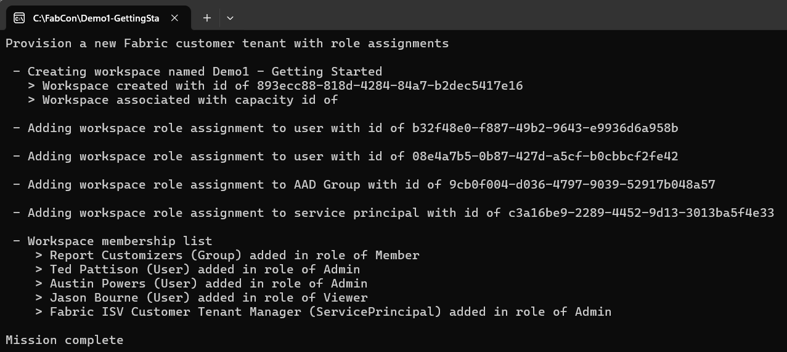
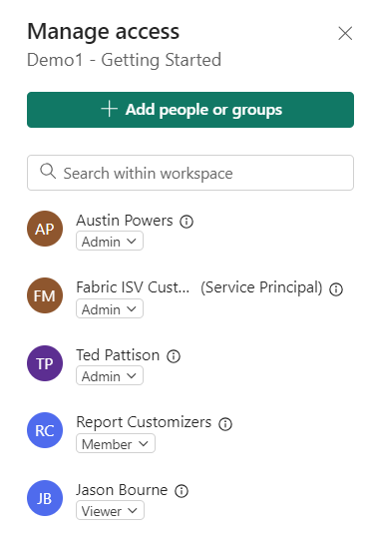
Running Demo1-GettingStarted

Slide 29
Agenda
Getting Started with the Fabric User APIs
Programming CreateItem using Item Definitions
Automating ALM and CI/CD with GIT Integration
Programming with Lakehouses and Notebooks
Provisioning and Building Data Warehouses
Accessing OneLake using the ADLS Gen2 APIs
Creating OneLake Shortcuts and Data Pipelines
Developing with Power BI Embedding on Fabric

Slide 30
Programming CreateItem using Item Definitions
Agenda for the Programming CreateItem using Item Definitions session
Getting Away from Deployment and ALM using PBIX Files
Understanding Fabric Item Definitions
Calling CreateItem to Create Semantic Models
Understanding Long Running Operations and Throttling
Calling CreateItem to Create Reports
Reverse-engineering Item Definitions using Get Item Definition
Updating Items using Update Item Definition

Slide 31
Getting Away from Deployment and ALM using PBIX Files
Managing definitions for datasets and reports in Power BI has been difficult
Common to package dataset and report definitions in PBIX files created with Power BI Desktop
To developers, PBIX file is a black box that provides no ability to read or write what's inside
Developer uses Imports API to publish PBIX files which creates datasets and reports
ALM and CI/CD become problematic when managing datasets and reports using PBIX files
Fabric User API introduces much better way to create items and to manage ALM
Provides developer with full control when creating, reading or updating item definitions
Fabric User API allows developers to move past limitations of working with PBIX files
New APIs include Create Item, Get Item Definition and Update Item Definition

Slide 32
Understanding the Abstraction of a Workspace Item
Fabric platform introduces unified Item abstraction for workspace artifact types
Item types are categorized by Fabric Workload
Some item types created by calling Create Item and passing item definition e.g. semantic models, reports, notebooks, Spark job definitions and data pipelines
Other item types created as empty items by calling Create Item without passing item definition e.g. lakehouses and warehouse
Workspace Item Types by Workload
Supported
Power BI
Data Engineering
Data Warehouse
Data Factory
Real-time Analytics
Data Science
SemanticModel
Lakehouse
Warehouse
DataPipeline
EventHouse
MLExperiment
Coming Soon
Report
Notebook
MirroredWarehouse
Dataflow
KQLDatabase
MLModel
Unsupported
PaginatedReport
SparkJobDefinition
KQLDataConnection
Shortcut
KQLQueryset
Environment
Eventstream

Slide 33
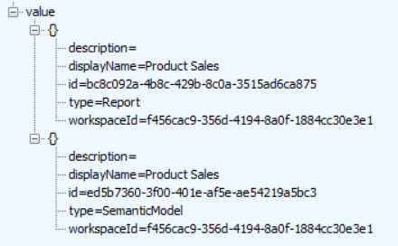
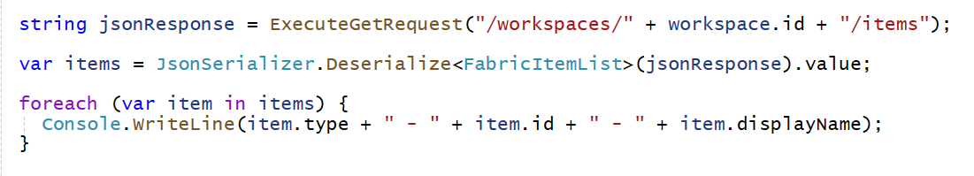
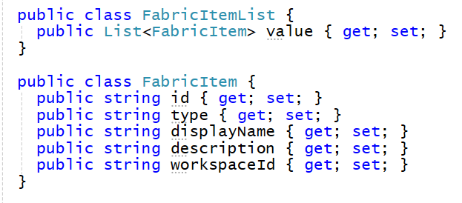
Discover Items in Workspace using List Items API
List Items API returns items for a specific workspace
Construct List Items API URL using target workspace Id and /items
List Items API supports type query string parameter to filter on item type
Your Application
Fabric User APIs
GET https://api.fabric.microsoft.com/v1/workspaces/{WORKSPACE_ID}/items
200 OK

Slide 34
Programming with Fabric Item Definitions
Fabric items can be created and updated using item definitions
You can pass item definition when calling Create Item API
You can retrieve item definition for existing Fabric item by calling Get Item Definition
You can modify existing workspace item by calling Update Item Definition passing item definition
Your Application
Fabric User APIs
Item
Definition
POST - Create Item
Item
Definition
GET - Get Item Definition
Item
Definition
POST - Update Item Definition

Slide 35
Fabric Item Definition Structure
When calling Create Item, you pass displayName, type and definition
Item definition includes array of parts where each part is item-specific file
File content for parts converted to/from inline base64 format when transmitted across network
Item definition for each item type requires unique set of parts
Creating semantic model definition requires parts for definition.pbidataset and model.bim
Creating report definition requires parts for definition.pbir, report.json and a report theme file
displayName:
Product Sales
displayName:
Sales by Product
type:
SemanticModel
type:
Report
definition:
definition:
parts: {
}
parts: {
}
definition.pbidataset
definition.pbir
model.bim
report.json
report-theme.json

Slide 36
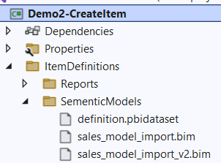
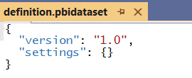
Creating Semantic Models
Developer must decide which type of semantic model to create
Import-mode models
DirectQuery models
DirectLake models
Item definition parts used to create semantic model
definition.pbidataset contains configuration data for model
model.bim contains semantic model definition

Slide 37
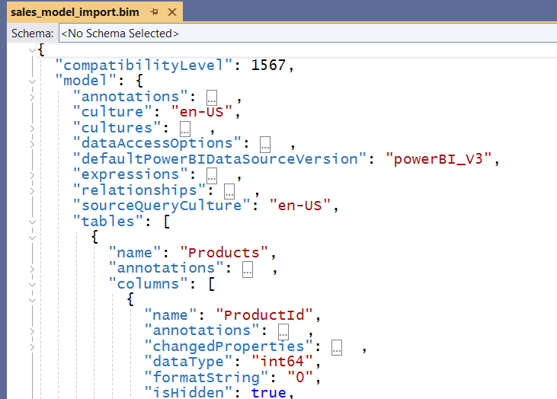
Managing Semantic Model Definitions using BIM Files
Semantic model definition can be maintained in BIM file format
Supported by Power BI Service and by Fabric
Supported by Tabular Editor and other community tools
Supported by Power BI Desktop with enabled preview feature for PBIP projects (discussed next section)

Slide 38
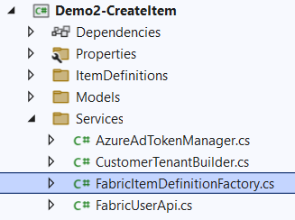
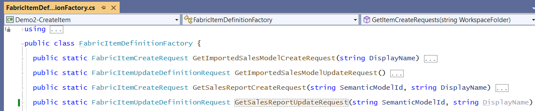
FabricItemDefinitionFactory
Demo2-CreateItem project contains FabricItemDefinitionFactory class
This class abstracts assembling JSON request body for Create Item request
FabricItemDefinitionFactory class provides method to create item definitions

Slide 39
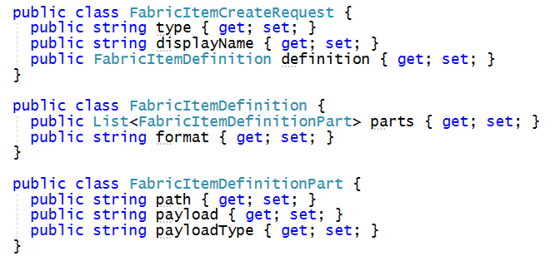
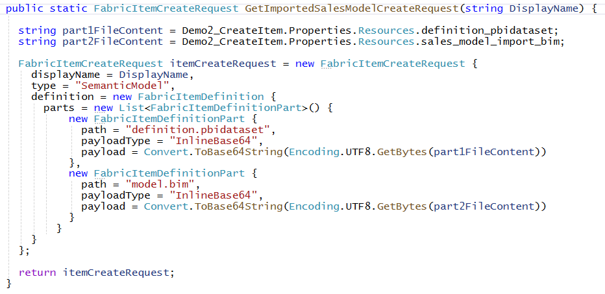
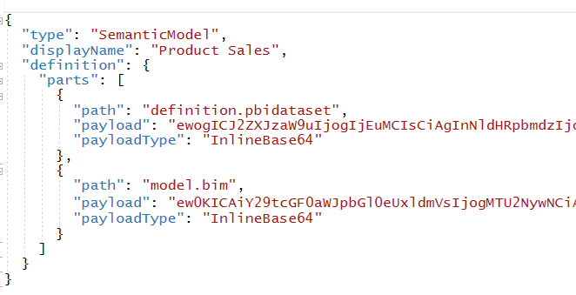
Assembling Item Definitions for Calls to CreateItem API
FabricUserApiModels.cs contains FabricItemCreateRequest serialization class
Use FabricItemCreateRequest class to assemble item definition for create request

Slide 40
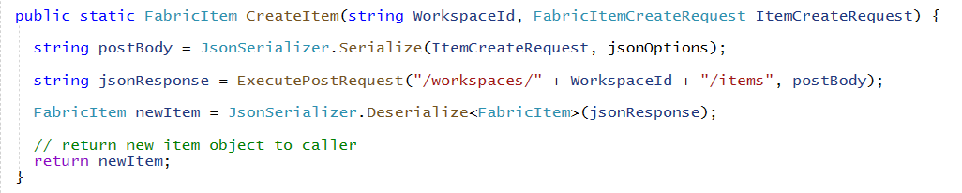
Creating Semantic Model using CreateItem
Call FabricUserApi.CreateItem passing FabricItemCreateRequest instance
CreateItem calls ExecutePostRequest to send request across network to Fabric User API
CreateItem implements Fabric User API Long Running Operations pattern
More on this topic after a few more slides

Slide 41
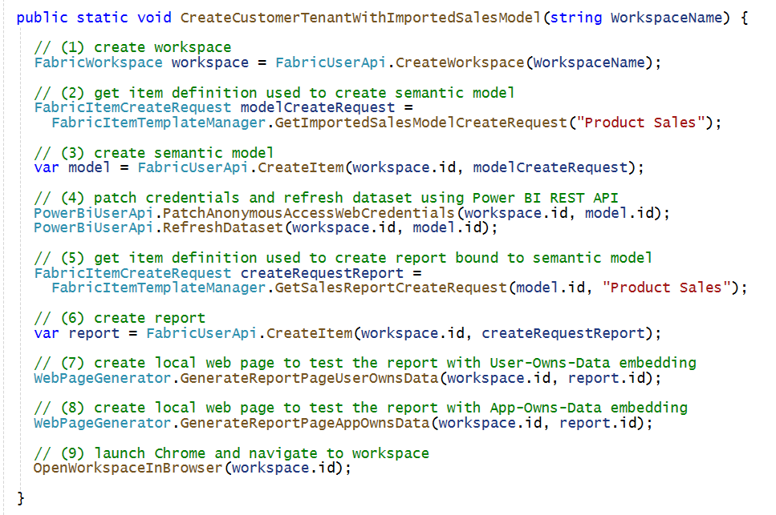
Preparing the Semantic Model After Creation
When you create a new import mode semantic model, you need to prepare it
Call to CreateItem creates semantic model definition but does not populate semantic model with data
You need to use the Power BI REST API to prepare the semantic model for consumption
First, you must patch credentials for the datasource(s) used by the semantic model
Second, you must initiate refresh operation

Slide 42
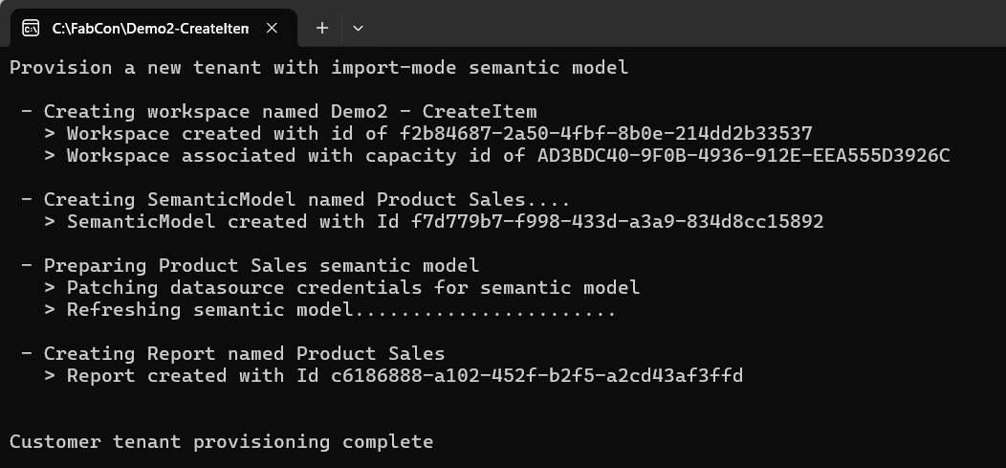
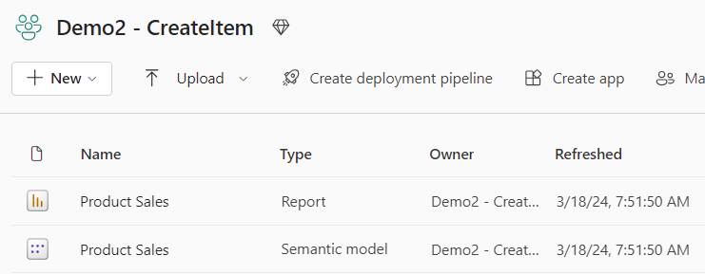
Customer Tenant Provisioning in Demo2-CreateItem
Flow to create import-mode semantic model and report
Create workspace and assign workspace members
Create import-mode semantic model using CreateItem API
Set semantic model credentials and run refresh operation using Power BI REST API
Create new report which is bound to import-mode semantic model using CreateItem API

Slide 43
Introducing Long Running Operations (LRO)
Fabric User API standardizes programming pattern for Long Running Operations (LRO)
Used to monitor and wait on asynchronous operating running in Microsoft cloud
Single endpoint may conditionally return either synchronous response and asynchronous response
CreateItem is good example of API that implements Long Running Operations pattern
CreateItem might return either 201 Created or 202 Accepted on successful call
CreateItem returns 201 Created when it successfully created the item in a synchronous operation
CreateItem returns 202 Accepted when it successfully starts async operation to create the item
ExecutePostRequest must be implemented to handle both 201 responses and 202 responses
Response headers in 202 Accepted response used to monitor Long Running Operations
Location response header contains URL to call Get Operation Status API
x-ms-operation-id response header contains GUID-based Id of operation
Retry-After response header contains number of seconds to wait

Slide 44
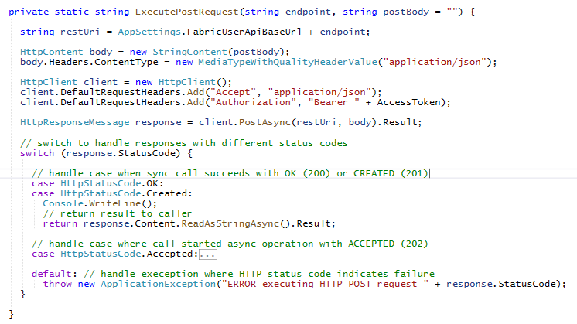
Long Running Operations – Part 1
ExecutePostRequest has conditional logic to handle 201 Created or 202 Accepted
Calls that return 201 Created are synchronous
Calls that return 202 Accepted are asynchronous and considered to be long running operations
synchronous operation
long-running operation

Slide 45
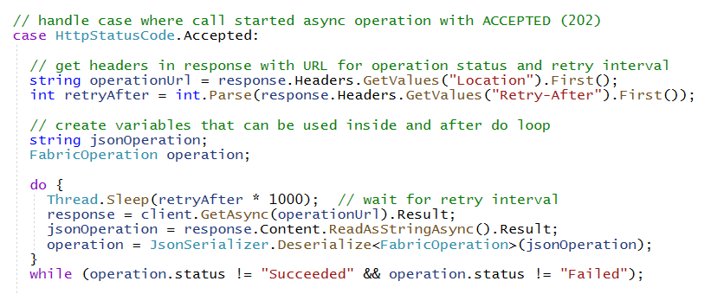

Long Running Operations – Part 2
Asynchronous calls which return 202 Accepted include two important response headers
Location response header provides URL to call Get Operation State API to get operation status
Retry-After response header returns number of seconds to wait before calling Get Operation State
Fabric User API enforces throttling to prevent caller from checking operation status too frequently
Calling too frequently in specific time window results in status code of 429 Too Many Requests
Developer should poll until response operation.status equals either Succeeded or Failed

Slide 46

Long Running Operations – Part 3
Poll by calling to Get Operation Status until operation.status == "Succeeded"
If response does not include Location header, that means there is no result to return to caller
If response includes Location header, then you should call Get Operation Result to fetch result
Add /result to end of URL in Location header to call Get Operation Result
Location header absent
Location header exists
Call to Get Operation Result

Slide 47
Binding Reports to Semantic Models
When creating report from item definition, you must bind report to semantic model
Report definition maintained report.json while definition.pbir only used to bind report to semantic model
Report definition has dependencies on names of tables, columns and measures in semantic model
Report has no dependencies on the type of underlying semantic model
Shared report definition can be bound to import-model semantic models and DirectLake semantic models
When you create a new report, you need to bind it to a target semantic model
When you create a new semantic model, you need to capture item Id returned from Create Item
When creating the item definition for the report, you use item Id for semantic model for binding
Capture model object
Pass model.id when creating item definition for report

Slide 48


Creating Report using CreateItem API
Creating report requires item definition with the following parts
definition.pbir –file containing metadata for Id of target semantic model
report.json – file containing report layout with pages and visuals
CY24su02.json –Power BI Desktop report theme file

Slide 49



Running Demo2-CreateItem

Slide 50



Exporting Existing Items using Get Item Definition
Get Item Definition API allows you retrieve item definition for existing items
Call Get Items to discover set of item Ids in workspace then call Get Item Definition once for each item Id
Make it possible to create a folder on local file system with set of files for each item definition part
Exported items definitions used to reverse engineering item definition parts needed for calling CreateItem
Your Application
Fabric User APIs
Item Definition
for Report
GET - Get Item Definition
Item Definition
for Semantic Model
GET - Get Item Definition

Slide 51
Updating Workspace Items using Update Item Definition
Use Update Item Definition API to update semantic models and reports
You can update semantic models and reports completely independent of one another
Your Application
Fabric User APIs
Item
Definition
POST - Update Item Definition

Slide 52

Creating Item Definition to Update Semantic Model
Use the same item definition passed to CreateItem with updated model.bim
Updated BIM file

Slide 53


Updating a Semantic Model
Your Application
POST https://api.fabric.microsoft.com/v1/workspaces/{WORKSPACE_ID}/items/{ITEM_ID}/updateDefinition
Fabric User APIs

Slide 54

Creating Item Definition to Update Report
Updated report.json file
Extend report with new built-in theme

Slide 55


Updating a Report
Your Application
POST https://api.fabric.microsoft.com/v1/workspaces/{WORKSPACE_ID}/items/{ITEM_ID}/updateDefinition
Fabric User APIs

Slide 56


Updated Semantic Model and Report

Slide 57
Agenda
Getting Started with the Fabric User APIs
Programming CreateItem using Item Definitions
Automating ALM and CI/CD with GIT Integration
Programming with Lakehouses and Notebooks
Provisioning and Building Data Warehouses
Accessing OneLake using the ADLS Gen2 APIs
Creating OneLake Shortcuts and Data Pipelines
Developing with Power BI Embedding on Fabric

Slide 58
Automating ALM and CI/CD with GIT Integration
Agenda for the Automating ALM and CI/CD with GIT Integration session
PBIP Projects in Power BI Desktop
Fabric Architecture for GIT Integration
Creating Projects in Azure Dev Ops
Connecting Fabric Workspaces to Azure Dev Ops Repositories
Creating and Syncing Workspace Connections using the Fabric User API
Managing Semantic Models using Tabular Model Definition Language (TMDL)

Slide 59




PBIP Projects in Power BI Desktop
Power BI Desktop supports Power BI Desktop Developer Mode (Preview)
Power BI Desktop has traditionally allowed saving projects in PBIX file format
Power BI Desktop now allows saving projects in Power BI Project (PBIP) format
Power BI Desktop saves semantic model definition using model.bim and definition.pbidataset
Power BI Desktop saves report definition using report.json and definition.pbir
.pbi folder used to store local resources that should not be saved into source control system

Slide 60


Motivation for PBIP File Format
Benefits of moving away from PBIX file deployment to PBIP file format deployment
Easy to create Item definition files (e.g. model.bim and report.json) that can be used to call CreateItem API
Item definition files can be stored in a source control system in more granular fashion
It makes it possible to view version history and compare different revisions (diff)
It makes it possible to revert to semantic models and reports to previous versions
Using PBIP with source control unblocks co-development with Power BI Desktop

Slide 61

Enabling the Power BI Project (.pbip) Save Option Feature
Make sure to upgrade Power BI Desktop to February 2024 release or later

Slide 62


GIT Integration with Fabric Workspace Connections
Fabric GIT Integration allows connecting Fabric workspace to GIT repository
Currently, Fabric only supports connecting workspaces to repositories in Azure Dev Ops
Product team currently working to add GIT integration support for GitHub (stay tuned)
Fabric Workspace - Customer 01
ADO Project - Customer 01
model
report
sync

Slide 63


Creating Workspace Connections By Hand
Workspace can be connected to Azure Dev Ops repository from Workspace Settings
First, you need to create an Azure Dev Ops project and initialize its main repository
Create workspace connection to ADO repository using Git Integration tab in Workspace Settings dialog
Once connected, workspace items list shows Git status

Slide 64

Item Definition Files Are Pushed to ADO Repository
Changes made in workspace items can be synced with ADO repository
Changes made to files in ADO repository can be synced with workspace items
sync

Slide 65
GIT Integration Flows for Multi-tenant Applications
Multi-tenant applications can automate creating/syncing GIT workspace connections
First flow demonstrates populating Fabric workspace with items and then syncing with ADO repository
Second first flow demonstrates adding source files to ADO repository and syncing to populate workspace
Fabric Multi-tenant Environment
Azure AD Tenant Owned by ISV
Azure Dev Ops Repositories
ADO Projects created & managed by ISV
Fabric Workspace - Customer 01
ADO Project - Customer 01
model
report
sync
Custom ISV Application
Fabric Workspace - Customer 02
ADO Project - Customer 02
model
report
sync

Slide 66


Creating Projects with the Azure Dev Ops REST API
Demo-GitIntegration project contains class named AdoProjectManager
AdoProjectManager uses Azure Dev Ops REST API to create and configure Azure Dev Ops projects
More info on this REST API at https://learn.microsoft.com/en-us/rest/api/azure/devops

Slide 67

First Demo: Push from Workspace to ADO Repository
Steps for the first demo
Create workspace and populate with semantic model and report
Create new project in Azure Dev Ops and initialize main repository
Create GitProviderConnection object containing details to create Git workspace connection
Pass GitProviderConnection object to FabricUserApi.ConnectWorkspaceToGitRepository
1
2
3
4

Slide 68

FabricUserApi.ConnectWorkspaceToGitRepository
Calling Git - Connect
Calling Git - Initialize Connection
Inspecting GitRequiredAction
Calling Git – Commit

Slide 69


Running Demo3-GitIntegration – Part1

Slide 70
Tabular Model Definition Language (TMDL)
Moving from PBIX to the PBIP file format with BIM files is a good first step
Now we will take it further by saving and maintaining semantic model definitions in TMDL file format
Benefits to saving semantic models in TMDL
Definition files created in human readable format using a YAML-like syntax
Better editing experience, especially for properties containing DAX and M expressions
Standard folder output format where each object in model has an individual file representation
TMDL file format is more source-control-friendly and better suited for collaboration and co-authoring
Get Started with TMDL
https://learn.microsoft.com/en-us/analysis-services/tmdl/tmdl-how-to?view=asallproducts-allversions
TMDL documentation
https://learn.microsoft.com/en-us/analysis-services/tmdl/tmdl-overview?view=asallproducts-allversions

Slide 71

Saving Semantic Model Definitions using TMDL
Enabled preview feature to store semantic model as TMDL instead of BIM file format

Slide 72




Examining TMDL Semantic Model Definition
Files for semantic model definition are split out in far more granular fashion
TMDL file content structured in YMAL format to increase readability and editability
Multiple developers can work on different tables at the same time without any conflict

Slide 73


TMDL Extension for Visual Studio Code
You can install the TDML extension in Visual Studio Code for better editing experience
TDML extension provides color coding and better YAML editing experience

Slide 74

Report Binding by Path
GIT Integration support binding report to semantic model by path
Eliminates need to patch definition.pbir file with target semantic model Id
NOTE: byPath reference only supported with Git Integration but not with CreateItem

Slide 75

Second Demo: Push from ADO Repository to Workspace
Steps for the second demo
Create new workspace and leave it empty
Create new project in Azure Dev Ops and upload PBIP project sources files for semantic model and report
Create GitProviderConnection object containing details to create Git workspace connection
Pass GitProviderConnection object to FabricUserApi.ConnectWorkspaceToGitRepository
Patch credentials and refresh semantic model
Synchronize workspace to ADO repository after refresh
1
2
3
4
5
6

Slide 76
FabricUserApi.ConnectWorkspaceToGitRepository
Calling Git - Connect
Calling Git - Initialize Connection
Inspecting GitRequiredAction
Calling Git – Update From Git

Slide 77


Running Demo3-GitIntegration - Part2

Slide 78
ALM and CI/CD Roadmap
Customers are asking for workspace-level configuration features
Working toward solving CI/CD problems with workspace-level parameterization
Goal is to enable item definitions to read workspace-level parameterization
Provide richer and developer-friendly format for report item definitions
Today, Fabric does not support direct edits to reports.json
Current format for reports.json is hard to read (JSON encoded as strings inside JSON – Yuck!)
All "supported" report editing must go through browser or Power BI Desktop
Dreaming of a better report.json…

Slide 79







Dreaming of a better report.json

Slide 80
Agenda
Getting Started with the Fabric User APIs
Programming CreateItem using Item Definitions
Automating ALM and CI/CD with GIT Integration
Programming with Lakehouses and Notebooks
Provisioning and Building Data Warehouses
Accessing OneLake using the ADLS Gen2 APIs
Creating OneLake Shortcuts and Data Pipelines
Developing with Power BI Embedding on Fabric

Slide 81
Programming with Lakehouses and Notebooks
Agenda for the Programming with Lakehouses and Notebooks section
Understanding Lakehouse Fundamentals
Ingesting and Transforming Data using Notebooks
Creating Lakehouses and Notebooks using CreateItem
Running Notebooks on Demand using Job Scheduler
Creating DirectLake Semantic Models on Lakehouse Tables

Slide 82

Fabric Lakehouse Fundamentals
Lakehouse used to store structured data and unstructured data in a single location
Lakehouse data transparently stored in OneLake using Azure Data Lake Storage Gen2 (ADLS Gen2)
Lakehouse data accessible across workloads like data engineering, data warehouse, data science & BI
Lakehouse enables storing and refining data using medallion architecture (bronze>silver>gold)
Lakehouse structure
Tables section used to store structure data in tables in Delta format
Files section used to store unstructured data as files

Slide 83
Ingesting Data into Lakehouse
Running Spark jobs
Running notebooks
Running Spark Job Definitions
Using ADLS Gen2 APIs
Implemented by client application which uploads files into lakehouse storage using push approach
Creating Shortcuts
Creating references to make files from an external source appear to be in lakehouse storage
Running Data Pipelines
Running data pipelines with activities to copy data from external sources
Running Fabric Gen2 Dataflows (still waiting on APIs ☹ )
Running a dataflow which imports data and saves it delta tables in lakehouse storage

Slide 84
Fabric Provides Apache Spark Runtime
Spark is a unified engine for large-scale data analytics
Spark code can be executed through Spark Job Definition
Spark code can be executed using interactive Fabric Notebook
Apache Spark provides APIs to read and write data to/from Lakehouse in OneLake
Spark supports several languages such as Python, Scala, SQL and R
Microsoft Fabric
Spark Job Definition
Apache Spark
Lakehouse
Python Runtime
Notebook

Slide 85

Code Walkthrough of Python Code in Notebook
Steps to provisioning flow which builds out medallion architecture
Create bronze layer by coping CSV files into Files section
Create silver layer by loading CSV data into dataframes and saving them as delta tables with OLTP schema
Create gold layer by transforming data from silver tables into delta tables with star schema

Slide 86






Using Spark Jobs to Create Lakehouse Tables
You can leverage Fabric support for Spark to create and populate lakehouse tables
Create lakehouse (or multiple lakehouses for greater isolation)
Create Spark Environment as workspace item for running Spark jobs (when Environments API becomes available)
Create Notebook (or Spark Job Definition) containing ETL logic to ingest data files and to create tables
Run Notebook using Job Scheduler – Run Job On-demand API
Customer Tenant Workspace
Environment
Lakehouse
bronze layer
silver layer
gold layer
Custom ISV Application
notebook
Spark job
Spark job
Spark job

Slide 87


Running Demo4-CreateLakehouse
Flow to create lakehouse tables, DirectLake semantic model and report
Create workspace associated with Premium capacity
Create notebook bound to lakehouse using lakehouse ID
Run notebook to ingest data from CSV files and generate lakehouse tables
Create DirectLake semantic model connected to lakehouse SQL endpoint
Patch DirectLake semantic model credentials and run refresh operation using Power BI REST API
Create new report which is bound to DirectLake semantic model

Slide 88



Creating Lakehouse using Create Item
Lakehouse created without item definition – you only pass displayName and type
Response from Create Item includes lakehouse id which is required to create notebooks
Code used in developer sample application to create lakehouse

Slide 89

CreateLakehouseTables.ipynb
Notebook created calling CreateItem with notebook part CreateLakehouseTables.ipynb
Notebook code and all other content stored in single JSON file with ipynb extension
Note: Fabric also supports calling CreateItem with standard Python file with py extension

Slide 90


Create Item Definition Part for Notebook
Notebook item template is .ipynb file containing placeholders
Placeholders used to substitute Ids for workspace and lakehouse
This substitution technique required to bind new notebook to existing lakehouse
Notebook Part Template with Placeholders
Notebook Part Instance passed to Create Item API
After Substitution

Slide 91



Creating Notebook using CreateItem
When creating item definition for notebook, set item definition format to ipynb
The demo flow creates notebook using CreateItem, then calls FabricUserApi.RunNotebook

Slide 92

Running Notebook with Job Scheduler API
Job Scheduler provides generic, on-demand execution API for runnable Fabric Items
Used to run Notebook
Used to run Spark Job Definitions
Used to run Data Pipelines
Running notebook on demand using Job Scheduler
Job Scheduler is async API similar to long-running operations (LRO)
Call Run On Demand Item Job API passing query string of jobType=RunNotebook
Successful call returns 202 Accepted and response header values for Location and Retry-After
You can use ExecutePostRequest to poll and wait for RunNotebook job to complete

Slide 93


Monitoring Job Instance
Use GET request to Job Scheduler - Get Item Job Instance API
Get Item Job Instance URL available in Location response header returned by initial POST request
/workspaces/{WORKSPACE_ID}/items/{WORKSPACE_ID}/jobs/instances/{INSTANCE_ID}
Checking on a job instance status by polling
Allows you to monitor if job has completed or still in progress
Status value moves from InProgress and Completed when job has successfully completed

Slide 94
Exposing Data to Consumers through the SQL Endpoint
Table data in lakehouse tables accessible through SQL endpoint
SQL endpoint automatically created for lakehouse
SQL endpoint provides read-only access for executing SQL queries
SQL endpoint provides data access to wide range of SQL-based applications
ISV AAD Tenant
Customer Tenant Workspace
SQL-based
Reporting Tools
Lakehouse
SQL Endpoint
SQL-based
Export Utilities
Custom SQL-based Applications

Slide 95

Lakehouse Properties
Retrieve lakehouse properties by executing GET request through /lakehouses endpoint
GET request with target URL of /workspaces/{WORKSPACE_ID}/lakehouses/{LAKEHOUSE_ID}
JSON response provides sqlEndpointProperties data required to create semantic model
Response also contains OneLake path properties used to access lakehouse storage
oneLakeFilesPath property contains path to unmanaged Files section of lakehouse file system
oneLakeTablesPath property contains path to managed Table section of lakehouse file system
Demo6-OnelakeFileWriter shows how to use these paths with ADLS Gen2 APIs to upload files to lakehouse
SQL Connection Info

Slide 96

Creating Semantic Models on Lakehouse Tables
Creating semantic model on lakehouse tables uses DirectLake mode
Semantic model created by passing model.bim to Create Item API
Semantic model allow you to define relationships, measures, hierarchies, etc.
CAVEAT: DirectLake semantic models do not support many import-mode features
Customer Tenant Workspace
Lakehouse
Semantic Model (aka Dataset)
SQL Endpoint

Slide 97


Creating BIM File for DirectLake Semantic Model
Add DatabaseQuery expression which defines connection to SQL endpoint
Reference DatabaseQuery as expressionSource in partition for each table definition

Slide 98


Creating DirectLake Semantic Model using CreateItem
Create item definition using BIM file updated with SQL endpoint information
Create semantic model using CreateItem then patch credentials and refresh

Slide 99
Creating and Exposing Power BI Reports
Reports can be built on top of DirectLake models
Power BI reports can provide rich interactive experience for users
Report can be made accessible to licensed users through Power BI service
Report can be made accessible to licensed users through User-Owns-Data embedding
Report cannot yet be made accessible to external users through Apps-Owns-Data embedding (coming soon)
Customer Tenant Workspace
Lakehouse
Semantic Model (aka Dataset)
report
Consumers
SQL Endpoint
report
Consumers
report
Consumers

Slide 100



Running Demo4-CreateLakehouse

Slide 101
Agenda
Getting Started with the Fabric User APIs
Programming CreateItem using Item Definitions
Automating ALM and CI/CD with GIT Integration
Programming with Lakehouses and Notebooks
Provisioning and Building Data Warehouses
Accessing OneLake using the ADLS Gen2 APIs
Creating OneLake Shortcuts and Data Pipelines
Developing with Power BI Embedding on Fabric

Slide 102
Provisioning and Building Data Warehouses
Agenda for the Provisioning and Building Data Warehouses section
Understanding Fabric Data Warehouse Fundamentals
Designing a Provisioning Flow to Build a Data Warehouse
Creating a Data Warehouse using CreateItem
Connecting to SQL Endpoint of a Data Warehouse
Executing SQL Statements to Build Table Schema for Data Warehouse

Slide 103
Fabric Data Warehouse Fundamentals
What are the similarities between a Lakehouse and a Warehouse
They expose delta tables (structured data) to consumers through a SQL endpoint
Their SQL endpoint can serve as datasource for a DirectLake semantic model
What's the advantage of a Lakehouse over a Warehouse?
Lakehouse has Files section to store unstructured data
Lakehouse storage accessible to Notebooks and Spark Job Definitions that use Spark APIs
Lakehouse provides a platform to run heavily-computational processes for machine learning and AI
What's the advantage of a Warehouse over a Lakehouse ?
Warehouse has SQL endpoint that is read-write
Creating tables and adding rows to warehouse accomplished by executing SQL statements
Warehouse provides transactional operations while lakehouse does not
Warehouse serves as a SQL MPP Engine (massively parallel processing engine)

Slide 104
Provisioning Flow for Building Out Data Warehouse
Steps in provisioning a data warehouse
Create workspace associated with premium capacity
Create lakehouse name staging
Create and run notebook to create & populate tables in staging lakehouse
Create data warehouse named sales
Connect to SQL endpoint of data warehouse using Microsoft.Data.SqlClient
Execute SQL statements to create stored procedures in warehouse
Execute stored procedure to create a set of tables in warehouse
Execute stored procedures to populate each of the tables
Create semantic model on top of warehouse tables
Create report which is bound to semantic model

Slide 105


Running Demo5–CreateWarehouse

Slide 106




Demo5 – CreateWarehouse Provisioning Flow
Custom ISV Application
Customer Tenant Workspace
Warehouse - Sales
Semantic Model
Gold layer
report
SQL Commands
SQL Endpoint
report
Lakehouse - Staging
Silver layer
Run Python Notebook
bronze layer
Run Python Notebook

Slide 107

Create Warehouse and Establishing SQL Connection
High-level steps for building out data warehouse
Create data warehouse
Get connection info for SQL endpoint
Establish connection to SQL endpoint and execute SQL statements

Slide 108

The SqlConnectionWriter Class
Demo5-CreateWarehouse projects includes custom SqlConnectionWriter class
Abstracts away code to establish connection to SQL endpoint and execute SQL statements
Uses classes from Microsoft.Data.SqlClient including SqlConnection and SqlCommand
Calls AzureAdTokenManager.GetAccessTokenForSqlEndPoint to acquire access token to access SQL endpoint

Slide 109

GetAccessTokenForSqlEndPoint
AzureAdTokenManager class contain GetAccessTokenForSqlEndPoint method
Authenticates with special application Id used by Microsoft.Data.SqlClient package
Acquires access token with SQL-specific delegated permission https://database.windows.net//.default
This is really funky. You must pass two forward slashes instead of one slash
Passing //.default works
Passing /.default does not work

Slide 110

SQL Used To Build Out Data Warehouse
ItemDefinitions/SQL folder contains *.sql files with SQL statements
These are the SQL statements that are executed to build out the tables in the data warehouse

Slide 111

Building Out Warehouse with Tables
Demo5-CreateWarehouse application executes SQL to build out warehouse

Slide 112


Populate Warehouse by Creating Stored Procedures
ISV application begins by executing SQL commands to create stored procedures
Custom ISV Application
SQL Commands

Slide 113




Populating Warehouse Tables from Lakehouse Tables
SQL INSERT INTO commands used to populate warehouse tables
SQL command uses SELECT FROM staging.dbo.table_name to pull from lakehouse tables
SQL used to transform and reshape data from normalized OLTP schema into star schema
SQL logic used to build calendar table

Slide 114



Running Demo5–CreateWarehouse

Slide 115
Agenda
Getting Started with the Fabric User APIs
Programming CreateItem using Item Definitions
Automating ALM and CI/CD with GIT Integration
Programming with Lakehouses and Notebooks
Provisioning and Building Data Warehouses
Accessing OneLake using the ADLS Gen2 APIs
Creating OneLake Shortcuts and Data Pipelines
Developing with Power BI Embedding on Fabric

Slide 116
Accessing OneLake using the ADLS Gen2 APIs
Agenda for the Accessing OneLake using the ADLS Gen2 APIs section
ADLS Gen2 API Fundamentals
Configuring OneLake in the Fabric Admin Portal
Accessing OneLake using ADLS Gen2 APIs
Accessing OneLake using Azure Storage Explorer
Integrating ADLS Gen2 APIs into a Provisioning Flow
Uploading Files to a Lakehouse using ADLS Gen2 APIs
Loading Tables from Files using the Load Tables API

Slide 117

ADLS Gen2 API Fundamentals
ADLS Gen2 APIs
Microsoft's primary REST APIs for interacting with Azure Blog storage and Azure Data Lake storage
ADLS Gen2 APIs can be used for uploading, downloading and transferring files
Azure Data Lake Storage Gen2 REST APIs Documentation
ADLS Gen2 API .NET SDK
Set of .NET class wrappers which adds a valuable productivity layer when programming in C#
ADLS Gen2 API .NET SDK Documentation
CAVEAT: ADLS Gen2 API documentation does not cover any details specific to OneLake
Some functionality provided by ADLS Gen2 APIs not available when accessing OneLake
Examples of these features includes creating storage containers and programming permissions

Slide 118

Configuring OneLake in the Fabric Admin Portal
Access to OneLake using ADLS Gen2 APIs can be enabled/disabled
These settings must be enabled to successfully access to OneLake storage
They are enabled by default but can be disabled by Fabric Administrator

Slide 119
Accessing OneLake using ADLS Gen2 APIs
All access to Azure storage for OneLake accessible through a single URL
Base URL for Fabric public cloud is https://onelake.dfs.fabric.microsoft.com
Base URL for OneLake will be different when accessing other Microsoft clouds
Access lakehouse storage using name of workspace and name of lakehouse/warehouse
https://onelake.dfs.fabric.microsoft.com/{WORKSPACE_NAME}/{ITEM_NAME}.{ITEM_TYPE}/{FILE_PATH}/{FILE_NAME}
Access lakehouse storage using Id of workspace and Id of item
Using IDs instead of names is much less problematic
https://onelake.dfs.fabric.microsoft.com/{WORKSPACE_ID}/{ITEM_ID}/{FILE_PATH}/{FILE_NAME}
OneLake also supports the Azure Blob Filesystem driver (ABFS)
abfss://{WORKSPACE_ID}@onelake.dfs.fabric.microsoft.com/{ITEM_ID}/{FILE_PATH}/{FILE_NAME}

Slide 120








Accessing OneLake using Azure Storage Explorer
create new connection

Slide 121
ISV Flow using ADLS GEN2 APIs and Load Table API
New integration flow to populate delta tables from uploaded data files
ADLS Gen2 API used to upload CSV and/or PARQUET files to Files section in lakehouse
Tables – Load Table API used to load delta table from data file
Customer Tenant Workspace
Lakehouse
Custom ISV Application
Files section
Tables section
ADLS Gen2 API
Tables – Load Table API

Slide 122


Demo6-OnelakeFileWriter Provisioning Flow
Custom ISV Application
Customer Tenant Workspace
Warehouse - Sales
Semantic Model
Gold layer
report
SQL Commands
SQL Endpoint
report
Lakehouse - Staging
Silver layer
Tables –Load Table
bronze layer
ALDLS Gen2 API

Slide 123


Examining the Demo6-OnelakeFileWriter Project
Base URL for OneLake maintained in AppSettings.cs
Demo6-OnelakeFileWriter project contains a class named OneLakeFileWriter
This class abstracts way code that uploads files to lakehouse storage using ADLS Gen2 APIs
Requires project dependencies on .NET packages named Azure.Storage.Files.DataLake and Azure.Identity

Slide 124

Code Walkthrough of OneLakeTokenCredentials Class
The OneLakeFileWriter class relies on utility class named OneLakeTokenCredential
TokenCredential used to acquire access token with delegated permission for Azure storage
The delegated permissions required for OneLake access is https://storage.azure.com/user_impersonation

Slide 125

Walkthrough of OneLakeFileWriter Class

Slide 126

Uploading Data Files and Loading as Delta Tables

Slide 127

FabricUserApi.LoadLakehouseTableFromParquet()
LoadLakehouseTableFromParquet used to load delta table from parquet file in Files section
This method calls Tables – Load Table endpoint in Fabric User API
FabricUserApi also contains LoadLakehouseTableFromCsv method

Slide 128


Running Demo6-OneLakeFileWriter

Slide 129
Agenda
Getting Started with the Fabric User APIs
Programming CreateItem using Item Definitions
Automating ALM and CI/CD with GIT Integration
Programming with Lakehouses and Notebooks
Provisioning and Building Data Warehouses
Accessing OneLake using the ADLS Gen2 APIs
Creating OneLake Shortcuts and Data Pipelines
Developing with Power BI Embedding on Fabric

Slide 130
Creating OneLake Shortcuts and Data Pipelines
Agenda for the Creating OneLake Shortcuts and Data Pipelines section
Waiting on Fabric CRUD API for Connections
OneLake Shortcut Fundamentals
Creating Shortcuts by Hand
Creating Shortcuts using the Fabric User APIs
Integrating Shortcuts into a Provisioning Flow
Data Pipeline Fundamentals
Creating Data Pipelines by Hand
Creating Data Pipelines using the Fabric User APIs
Integrating Data Pipelines into a Provisioning Flow

Slide 131
Waiting on Fabric CRUD API for Connections
As of March 2024, there is no Connections API
CRUD API for Connections expected by May 2024
Lack of connections API causes blocking issues for some workspace item
Semantic Models
Shortcuts
Data Pipelines
In the meantime….
Create connections by hand and hardcode ConnectionId into test code

Slide 132


OneLake Shortcut Fundamentals
What is a OneLake shortcut?
A shortcut is an OneLake object that points to another internal or external storage locations
Shortcuts can be created in lakehouses and Kusto Query Language (KQL) databases
OneLake supports shortcuts targeting external locations in ADLS storage, Amazon S3 storage and Dataverse
Shortcuts behave like symbolic links
Shortcuts are independent objects from the target source
If you delete a shortcut, the target remains unaffected
If you move, rename, or delete a target path, the shortcut can break
Shortcut acts as pointer to storage location
Shortcut has unique icons

Slide 133








Creating Shortcuts by Hand

Slide 134

Inspecting Shortcuts using Get Shortcuts API
You can inspect shortcuts in a lakehouse using Get Shortcuts API
/workspaces/{WORKSPACE_ID}/items/{LAKEHOUSE_ID}/shortcuts
Returns JSON result with target properties for source such as oneLake or adlsGen2
Inspecting JSON allow you to reverse engineer shortcuts created by hand
You can also capture connectionId from connections created by hand

Slide 135

Serialization Classes for Shortcut Create Requests

Slide 136


FabricUserApi.CreateLakehouseShortcut
CreateLakehouseShortcut executes HTTP POST request to Create Shortcut API
POST /workspaces/{WORKSPACE_ID}/items/{LAKEHOUSE_ID}/shortcuts
Calling CreateLakehouseShortcut using LakehouseShortcutCreateRequest instance

Slide 137



Creating Shortcuts – Example 1
Creating shortcut to folder in lakehouse in a different workspace
You can now access files in shortcut folder as if they were native to this lakehouse

Slide 138



Creating Shortcuts – Example 2
Creating shortcut to folder in ADLS Gen2 storage container
You can now access files in shortcut folder as if they were native to this lakehouse

Slide 139



Creating Shortcuts – Example 3
Creating shortcuts to tables from lakehouse in another workspace
You can now access the table shortcuts as if they were native tables in this lakehouse

Slide 140

Demo7-CreateShortcut Provisioning Flow
Custom ISV Application
Customer Tenant Workspace
Warehouse - Sales
Semantic Model
Gold layer
report
SQL Commands
SQL Endpoint
report
Lakehouse - Staging
Silver layer
Tables –Load Table
bronze layer
Create Shortcut API

Slide 141

Running Demo7-CreateShortcut

Slide 142
Data Pipeline Fundamentals
Fabric Data Factory provides two types of workspace items used to process ETL
Data Pipelines (APIs coming soon)
Gen2 Dataflows (APIs ETA TBD)
Data pipeline allows author to create workflows with ETL-related activity
Data pipeline is set of parameterized activities designed to ingest and transform data
Data pipeline often created to copy data into lakehouse
Fabric provides browse-based experience for authoring data pipelines
Item definition for data pipeline maintained in JSON format

Slide 143





Creating a New Data Pipeline by Hand
Step to create a new data pipeline
Add Copy data activity and select a datasource

Slide 144








Authoring Data Pipelines by Hand

Slide 145


CopySalesData.json
Demo8-CreateDataPipeline has data pipeline template for named CopySalesData.json
Template file has substitution placeholders for {CONNECTION_ID}, {WORKSPACE_ID} and {LAKEHOUSE_ID}

Slide 146


Creating a Data Pipeline Item Definition
Data pipeline created by calling CreateItem API with an item definition
Data pipeline item definition contains single part with path of pipeline-content.json
GetDataPipelineCreateRequest method substitutes placeholders with IDs for connection, workspace and lakehouse
Here’s what the JSON request body that is sent across the network looks when calling CreateItem

Slide 147


Creating Data Pipelines using the Fabric User APIs
Demo8-CreateDataPipeline creates & runs data pipeline to copy files to staging lakehouse
RunDataPipeLine runs data pipeline by calling Job Scheduler - Run On Demand Item Job
POST request sent with query string of jobType=Pipeline

Slide 148

Demo8-CreateDataPipline Provisioning Flow
Custom ISV Application
Customer Tenant Workspace
Warehouse - Sales
Semantic Model
Gold layer
report
SQL Commands
SQL Endpoint
report
Lakehouse - Staging
Silver layer
Create & Run Data Pipeline

Slide 149

Running Demo8-CreateDataPipline

Slide 150
Agenda
Getting Started with the Fabric User APIs
Programming CreateItem using Item Definitions
Automating ALM and CI/CD with GIT Integration
Programming with Lakehouses and Notebooks
Provisioning and Building Data Warehouses
Accessing OneLake using the ADLS Gen2 APIs
Creating OneLake Shortcuts and Data Pipelines
Developing with Power BI Embedding on Fabric

Slide 151
Developing with Power BI Embedding on Fabric
Agenda for the Developing with Power BI Embedding on Fabric section
User-Owns-Data Embedding
App-Owns-Data Embedding
Generating Embed Tokens
Power BI Embedding Roadmap

Slide 152
Power BI Embedding Fundamentals
Power BI Embedding allow developer to surface reports in custom applications
Power BI embedding has been supported for years – it is a mature development platform
Developer required to interact with Azure AD and Power BI REST API to acquire tokens and report metadata
Developer required to write client-side code in JavaScript or TypeScript using powerbi.js library
Embedding applications often developed using popular JavaScript frameworks such as React and Angular
There are two types Embedding: User-Owns-Data and App-Owns-Data
User-Owns-Data Embedding (aka Embed for your organization)
Reports embedding using Azure AD access token for current user
Users must have Azure AD work and school account and a Power BI License
App-Owns-Data Embedding (aka Embed for your customer)
Developer can use any identity provider – external users are unknown to Azure AD and Fabric
Developer responsible for designing/implementing custom authorization layer
Reports embedded in browser using embed token generated by developer with Power BI REST API

Slide 153


Getting Data Required for User-Owns-Data Embedding
Client-side code implementing report embedding needs the following data
User-Owns-Data embedding requires Azure AD access token and TokenType.Aad

Slide 154




WebPageGenerator Class
WebPageGenerator class implements simple testing process for embedding reports
WebPageGenerator class generates and launches HTML pages on local file system
WebPageGenerator

Slide 155

GenerateReportPageUserOwnsData
GenerateReportPageUserOwnsData generates the page for User-Owns-Data embedding
Uses EmbedReport.html as starting page template and overwrites substitution placeholders
Generates output page named SalesReport-UserOwnsData.html

Slide 156


Simple HTML Page Source for Power BI Embedding

Slide 157

Generating Embed Tokens
App-Owns-Data embedding requires developer to generate embed tokens
Developer must design custom authorization layer to determine access permissions for each external user
Developer grants permissions by adding IDs for workspaces, semantic models and reports to embed token
Support for generating embed tokens for DirectLake semantic models not available, but coming soon

Slide 158


GenerateReportPageAppOwnsData
GenerateReportPageAppOwnsData generates the page for App-Owns-Data embedding
Uses EmbedReport.html as starting page template and overwrites substitution placeholders
In report config, accessTokenType is set to TokenType.Embed
Generates output page named SalesReport-AppOwnsData.html

Slide 159
Fabric Embedding Roadmap
Short-term Improvements to Power BI Embedding
Allow editing of semantic models as embedded experience
Enable Co-pilot experiences for embedded reports
Long-term investment in New Fabric Embedding Model
Used to embed new Fabric experiences
Embed Fabric Notebooks to provide authoring experience
Embed Fabric Data Pipelines to provide authoring experience

Slide 160
Call to Action
Start using APIs and building provisioning flows
Import mode models
Lakehouse
Data warehouse
Give Us Feedback
Email me at Ted.Pattison@Microsoft.com and let is know what is important
Include company name
Quick Links to Workshop Material
GitHub: https://aka.ms/FabConWorkshop
Slides: https://aka.ms/FabConWorkshopSlides
Download: https://aka.ms/FabConWorkshopDownload

Slide 161
Summary
Quick Links to Workshop Material
GitHub: https://aka.ms/FabConWorkshop
Slides: https://aka.ms/FabConWorkshopSlides
Download: https://aka.ms/FabConWorkshopDownload
Getting Started with the Fabric User APIs
Programming CreateItem using Item Definitions
Automating ALM and CI/CD with GIT Integration
Programming with Lakehouses and Notebooks
Provisioning and Building Data Warehouses
Accessing OneLake using the ADLS Gen2 APIs
Creating OneLake Shortcuts and Data Pipelines
Developing with Power BI Embedding on Fabric

Slide 162

Quick Links to Workshop Material
GitHub: https://aka.ms/FabConWorkshop
Slides: https://aka.ms/FabConWorkshopSlides
Download: https://aka.ms/FabConWorkshopDownload

Slide 163


Slide 164


Slide 165


Slide 166


Slide 167


